Slide 1
Invertible
Notes:
If AB = $I_{n}$ or BA = $I_{n}$ then A is invertible with inverse B and B is invertible with inverse A.

Slide 2

Unique Inverse
Notes:
Invertible matrices only have one inverse.

Slide 3
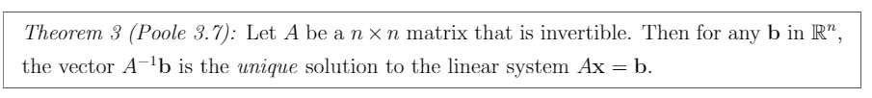
Invertible Unique Solution
Notes:
$A^{−1}b$ = x in Ax = b

Slide 4
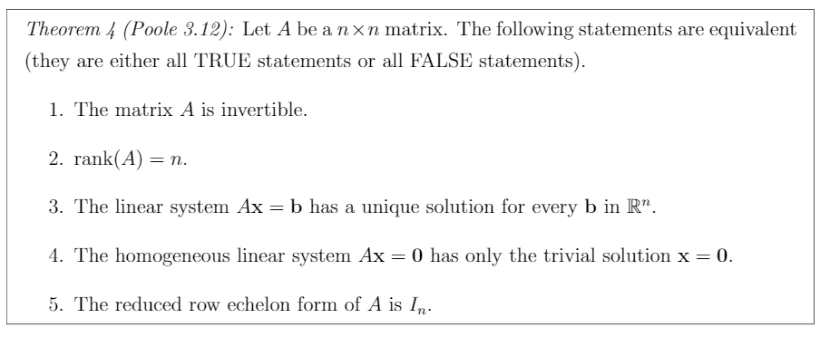
Fundamental Theorem of Invertible Matrices
Notes:
Memorize this, is pretty much used in most of this unit
A is invertible
rank(A) = n
Ax=b has no free variables and zero rows (excluding b).
Homogenous linear system Ax = 0 has only trivial solution x = 0.
A reduces to $I_{n}$

Slide 5
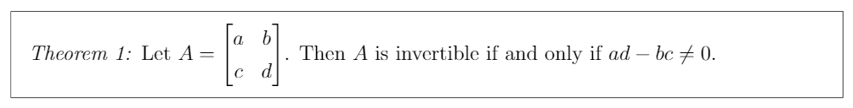
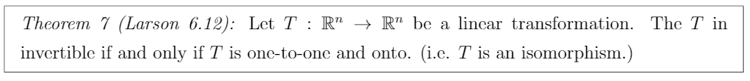
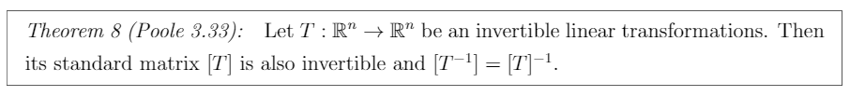
Other Invertible Properties
Notes:
Theorem 7 must be memorized. The previous slide can be used for Theorem 1’s case.

Slide 6
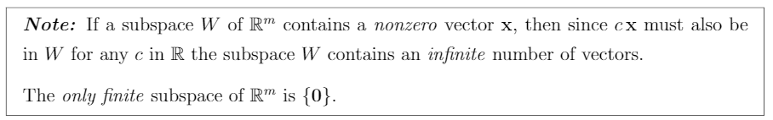
Finite, infinite subspaces
Notes:
Subspace contain every linear combination of nonzero vectors contained in it.
Only subspace {0} is finite.

Slide 7

Subspace
Notes:
The linear combination of the vectors in $R^{m}$ named W is a subspace of $R^{m}$.

Slide 8
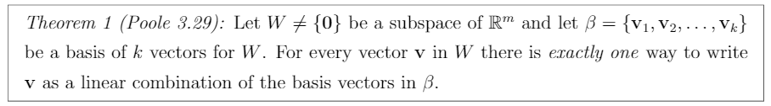
Basis
Notes:
Basis is the set of linearly independent vectors that represent subspace W which is not an empty set. (refer to slide 6 for info on subspaces)

Slide 9
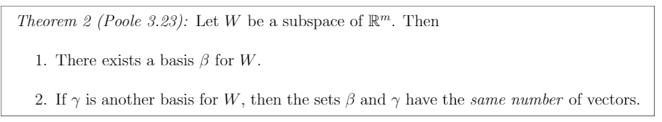
Subspace’s basis
Notes:
Any subspace W has:
A basis β for W
If another basis γ exist, β and γ have same number of vectors.

Slide 10
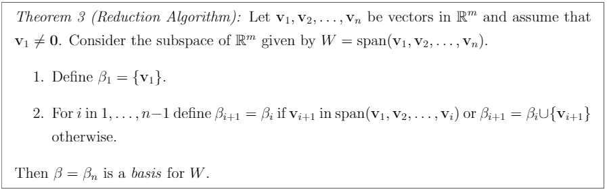
Reduction Algorithm
Notes:
Basically, how find the basis from a set of vectors. Look at the notes if you forgot how to find basis.
Note that you can row reduce the vectors; however, you must use the original vectors in your answer.

Slide 11
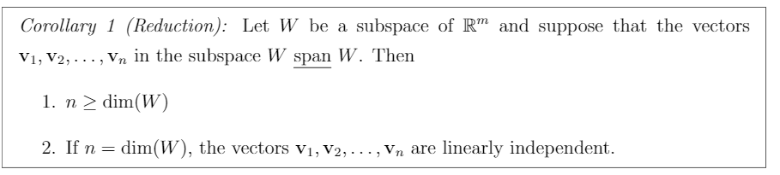
Reduction Corollary
Notes:
If the vectors $v_{1}$,…,$v_{n}$ in subspace W span W then:
n ≥ dim(W) (in order to span R2 for instance, we need at least 2 vectors).
If n = dim(W), $v_{1}$,…,$v_{n}$ are linear independent. (If we have 2 vectors in R2 that span R2, they must be pointing in different directions).
Note that n is the number of vectors in $v_{1}$,…,$v_{n}$.

Slide 12
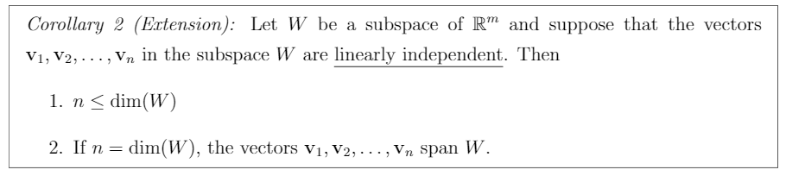
Extension Corollary
Notes:
If the vectors $v_{1}$,…,$v_{n}$ in subspace W are linearly independent then:
n ≤ dim(W) (Linear independent vectors cannot be reduced, therefore, the upper limit of n is the number of vectors in W).
If n = dim(W), $v_{1}$,…,$v_{n}$ span W. (If W consists of only linearly independent vectors, then those vectors generate all of W).

Slide 13
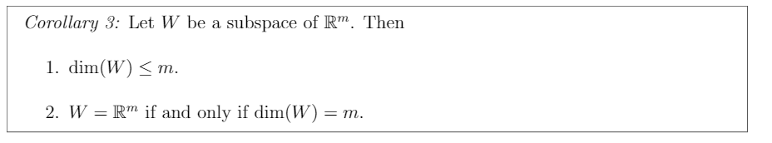
Subspace Properties
Notes:
If W is a subspace of $R^{m}$ then:
1. dim(W) ≤ m (If you have 3 linearly independent vectors, there exists 3 components in W (xyz) so W cannot exist in R2).
2. W = $R^{m}$ if and only if dim(W) = m (If you have 2 linearly independent vectors, they span R2, no exceptions)

Slide 14
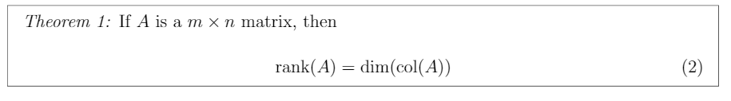
Rank & Column Dimension
Notes:
Memorize this.

Slide 15
Null and Subspace
Notes:
Null(A) is the subspace at which matrix Ax = 0.

Slide 16
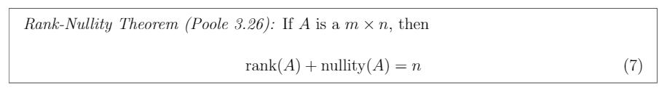
Rank Nullity Theorem
Notes:
Memorize

Slide 17
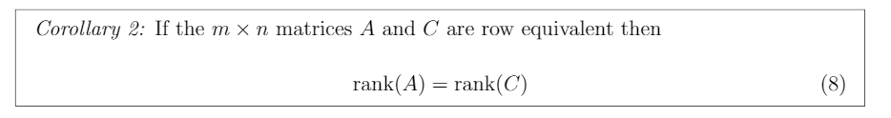
Row Equivalent Rank

Slide 18
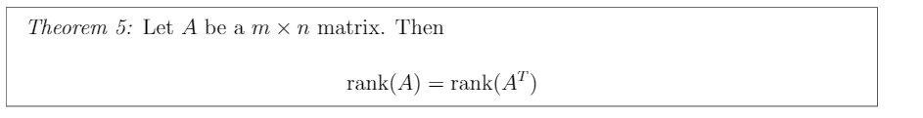
Rank vs Rank Transpose

Slide 19
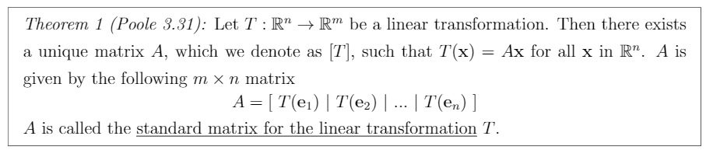
Standard Matrix

Slide 20
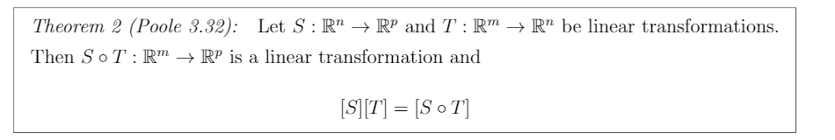
Standard Matrix Multiplication
Notes:
Think about multiplying matrices: Matrix 2x5 multiplying matrix 5x8 = Matrix size 2x8. In this case, you start off with T and multiply it by S to get Rm to Rp.

Slide 21
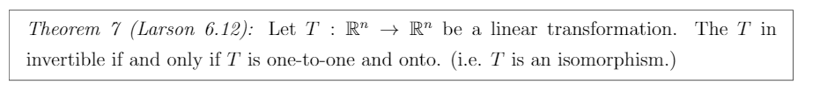
Isomorphism
Notes:
This theorem is included on slide 5: Other invertible properties.

Slide 22
Invertible Linear Transformation and Standard Matrix
Notes:
This theorem is included on slide 5: Other invertible properties.

Slide 23

Probability of State change
State j
State i
k steps
Notes:
For instance, if I wanted to see the probability of raining on Wednesday while it is sunny today (Sunny is S1 and Rainy is S2), I would calculate (P²)_{21,} note that the power 2 means in 2 steps or days and from matrix, column 1, row 2. I lose points somehow (reason was wrong) using this method on the homework so you can try P²x₀ where x₀ is the initial state vector when it is sunny. Got the same answer either way. You can also do x_{n+1}=Px_{n} to move one step at a time.

Slide 24
Infinite State change
Notes:
Null(P-I_{n}) then solve the resulting x₁…x_{n} for t (for instance, x₁+x₂+x₃=1) to get the steady state probability vector. Your vector must add up to one.

Slide 25

Determinant Invertibility Test
Notes:
This theorem is included on slide 5: Other invertible properties. They both mean the same thing.

Slide 26
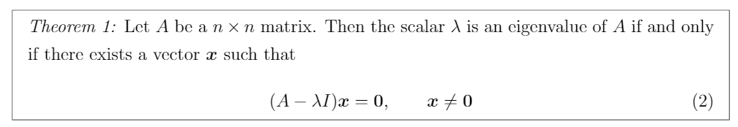
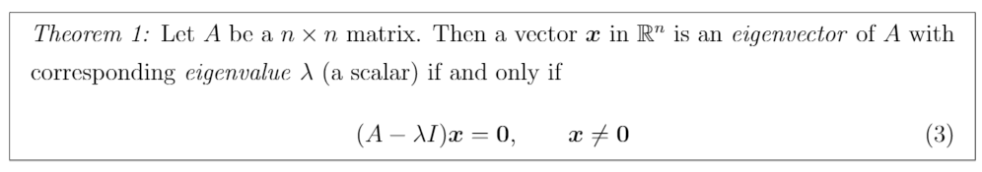
Eigenvalue and Eigenvectors

Slide 27
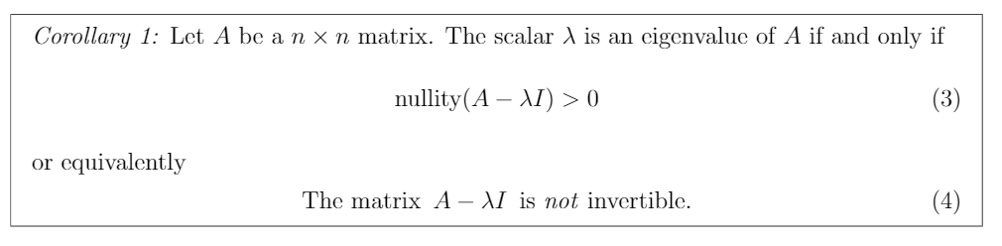
Rule For Eigenvalue
Notes:
Remember that nullity(A) = 0 means only the zero vector makes the homogenous linear system Ax = b = 0. According to the FTOIM, homogenous linear systems can only have the trivial solution x = 0; therefore, nullity must be zero.
Look at the cheat sheet, you need a nonempty null space to find an eigenvalue of a matrix.

Slide 28
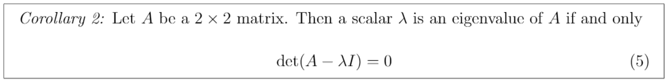
Finding Eigenvalues
Notes:
Solving the determinant for lambda to find the eigenvalues of matrix A.

Slide 29
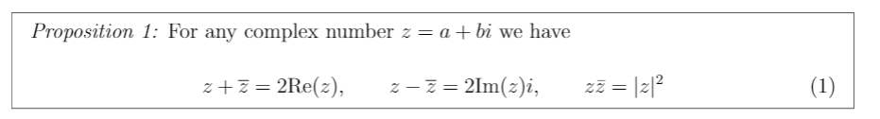
Complex Number Shortcuts

Slide 30
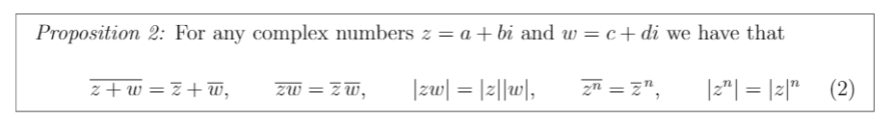
Complex Number Shortcuts

Slide 31
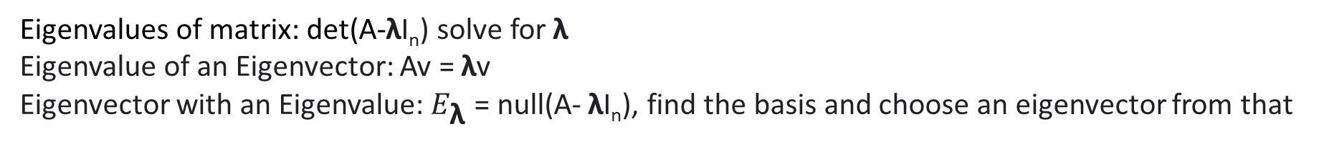
Eigenvalue and Eigenvector cheat sheet
Eigenvalues of matrix: det(A-λI_{n}) solve for λ
Eigenvalue of an Eigenvector: Av = λv
Eigenvector with an Eigenvalue: $E_{\text{λ}}$ = null(A- λI_{n}), find the basis and choose an eigenvector from that
Notes:
Note that $E_{\text{λ}}$=null(A-λI_{n}) is a subspace of R^{n}, therefore, (A-2I₃)[1,1,1]=[0,0,0] will have eigenvalue equal to 2 for all linear combinations of eigenvector [1,1,1] but [0,0,0]

